Slide 1
Go term visualisations
Jochum, Michael D.
2 November 2020

Slide 2
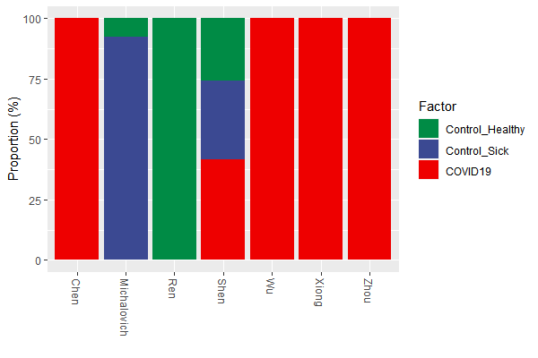
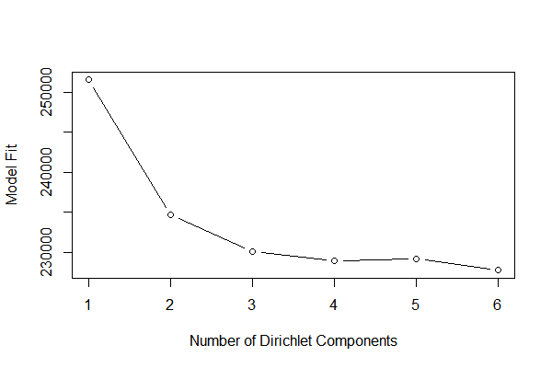
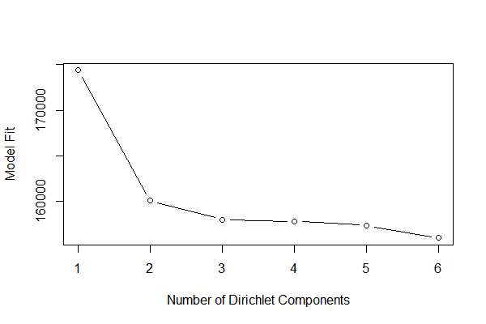
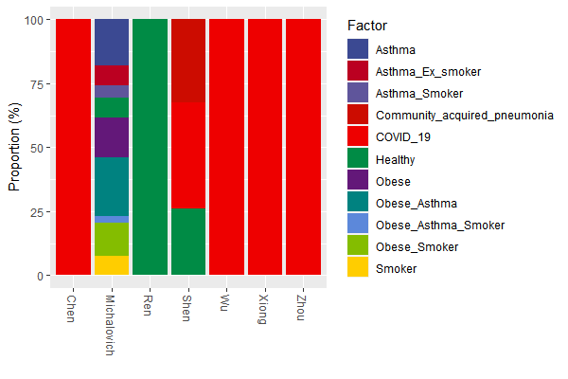
Subset GO_Terms for computational speed
pseq_prune
phyloseq-class experiment-level object otu_table()
OTU Table: [ 332 taxa and 134 samples ]
sample_data() Sample Data: [ 134 samples by 70 sample variables ]
tax_table() Taxonomy Table: [ 332 taxa by 3 taxonomic ranks ]
DMM model fit

Slide 3
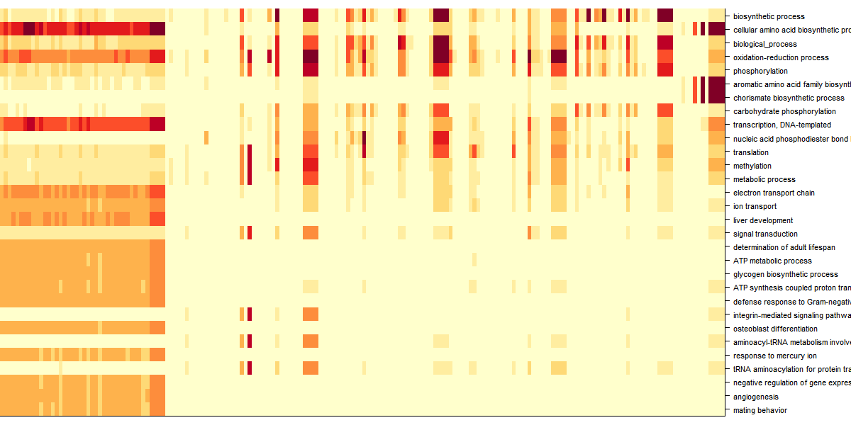
Dirichlet Multinomial Mixtures Community typing (k=6)

Slide 4
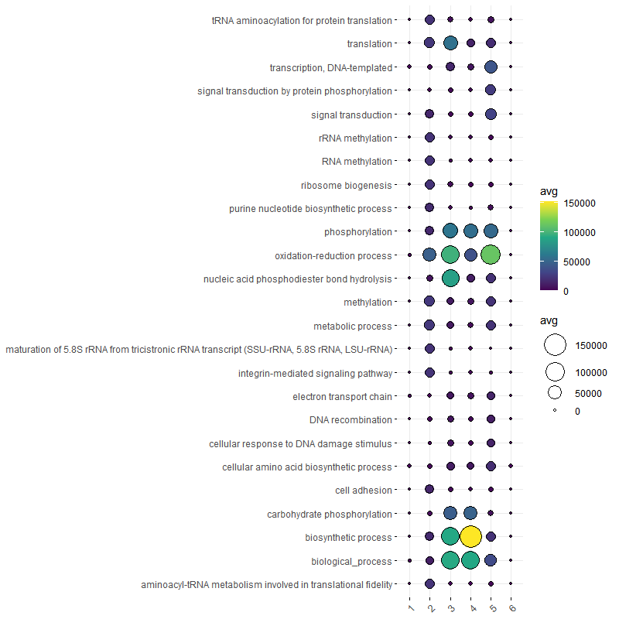
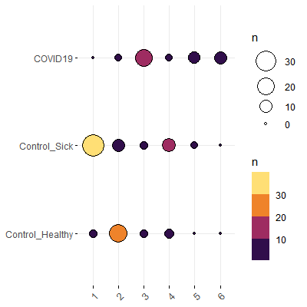
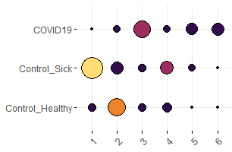
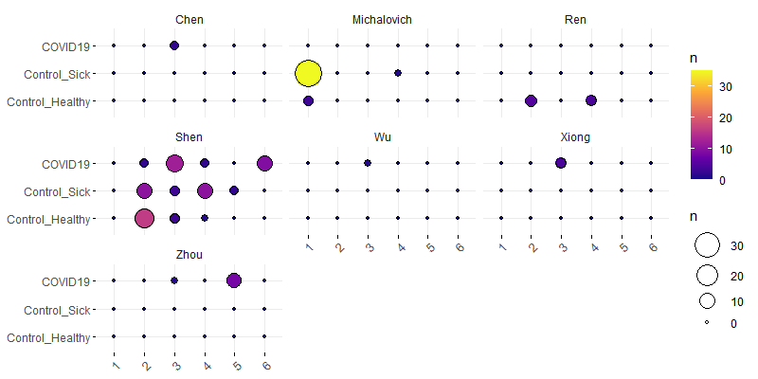
Bacteria derived biological process GO term Dirichlet Multinomial Mixtures Community typing (k=6)
DMM group (x) by case (y), colored by count
DMM group (x) by case (y) faceted by publication, colored by count

Slide 5
Go term visualisations
Jochum, Michael D.
27 Oct 2020

Slide 6
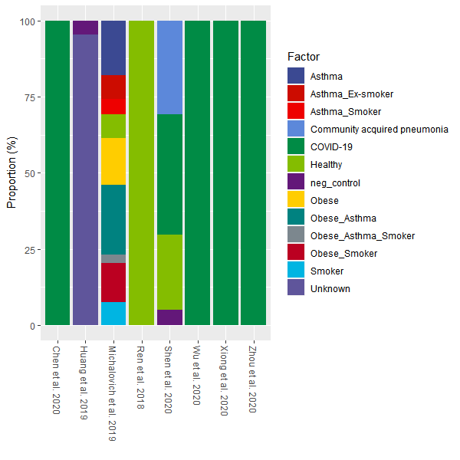
Proportion of samples types by publication

Slide 7
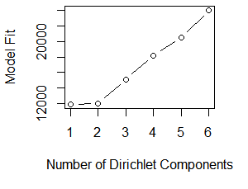
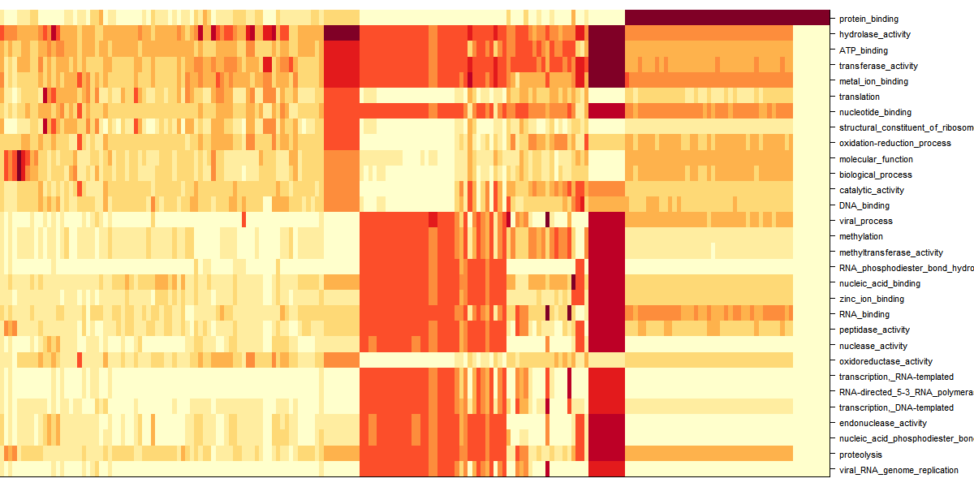
Dirichlet Multinomial Mixtures Community typing

Slide 8
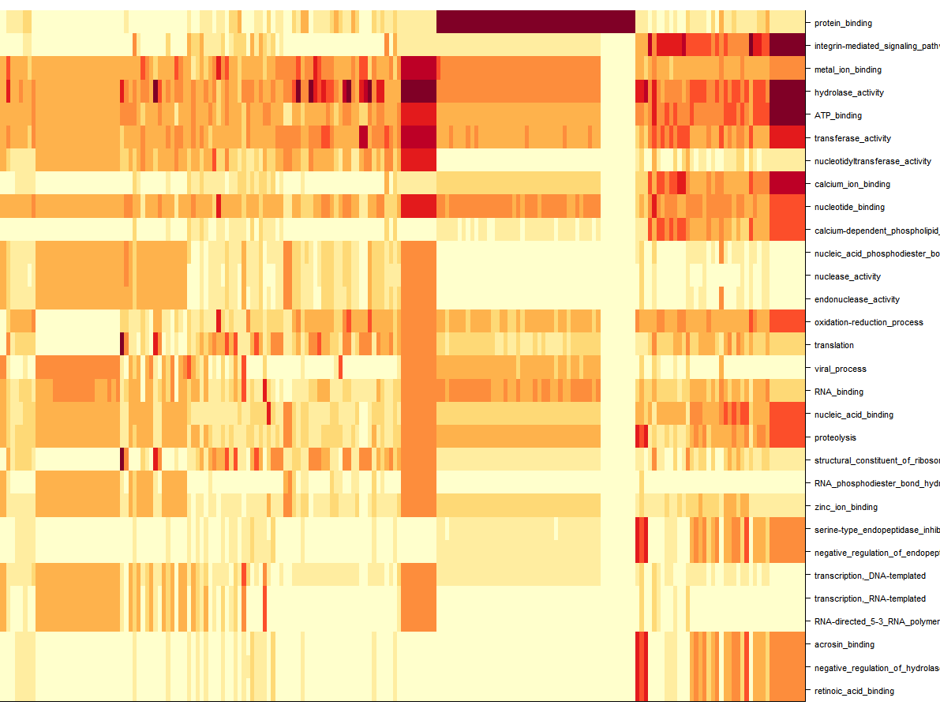
Dirichlet Multinomial Mixtures Community typing

Slide 9
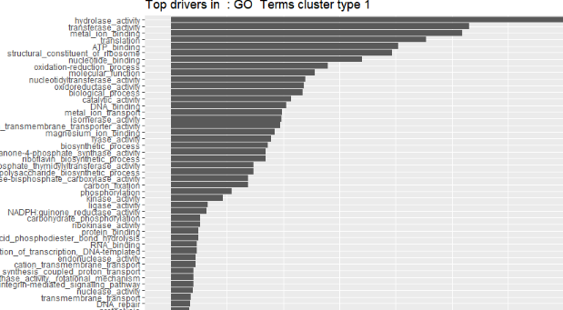
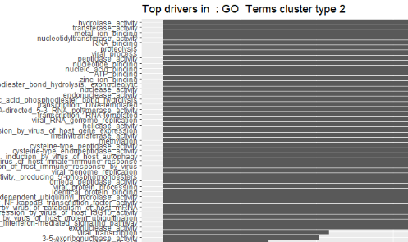
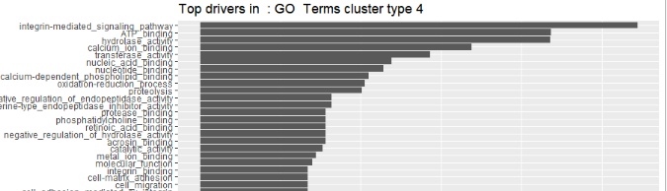
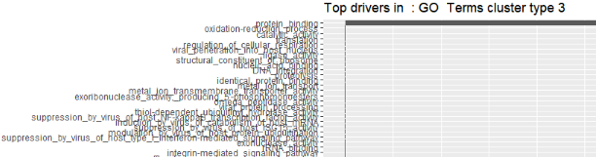
Dirichlet Multinomial Mixtures Community typing

Slide 10
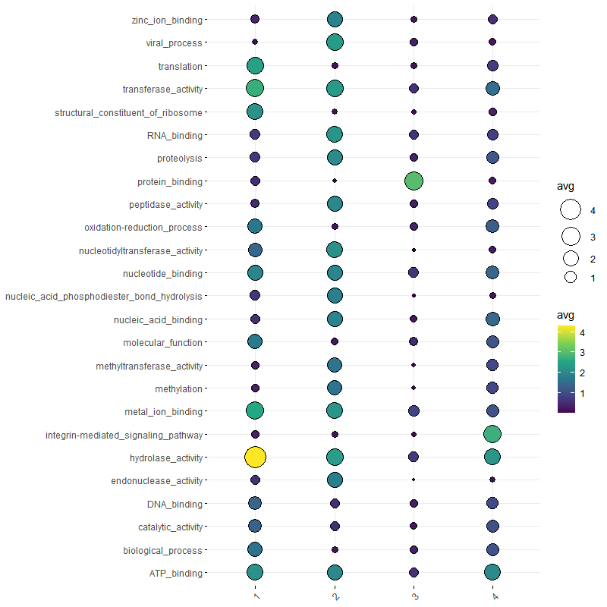
Dirichlet Multinomial Mixtures Community typing

Slide 11
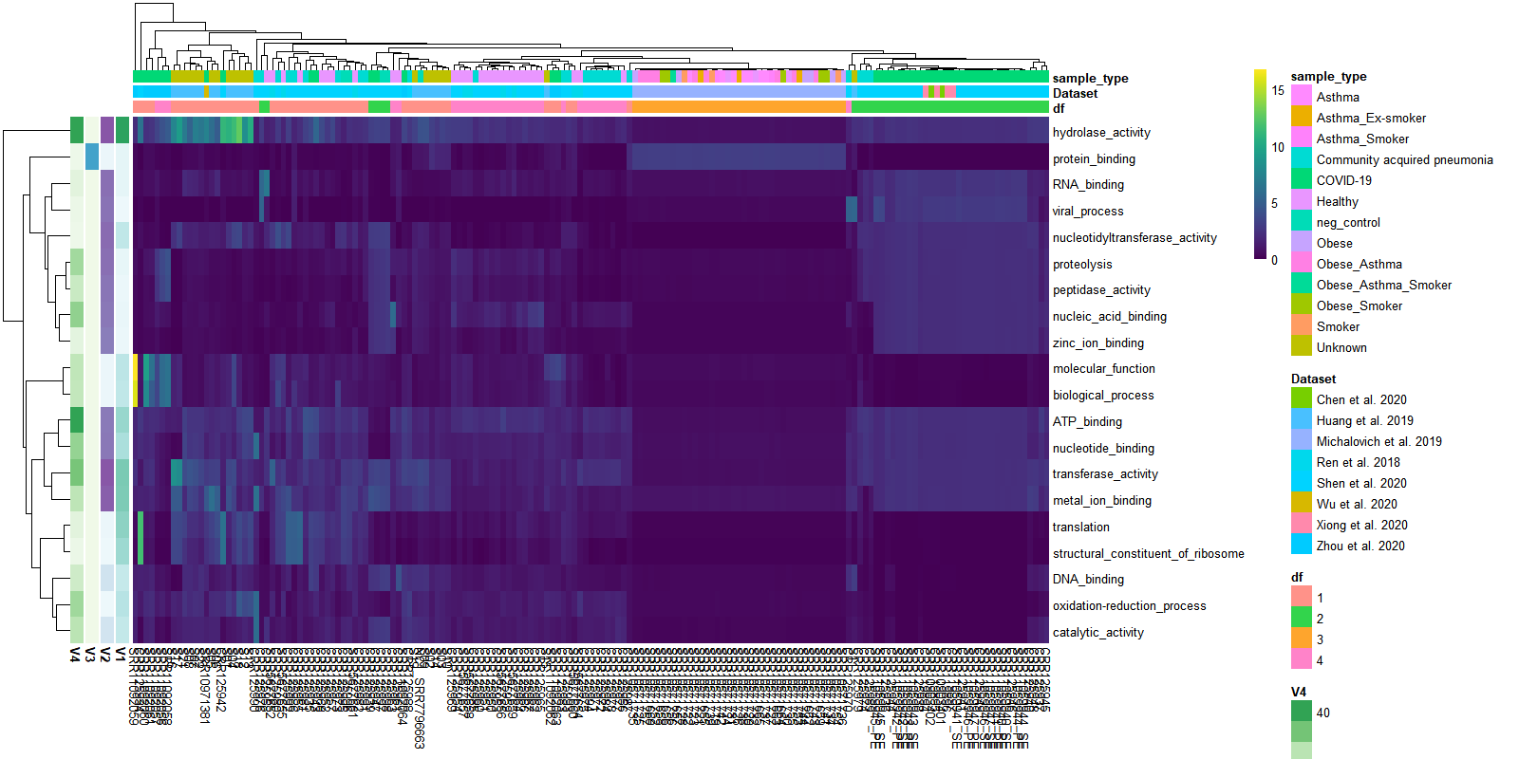
Dirichlet Multinomial Mixtures Community typing

